Slide 1
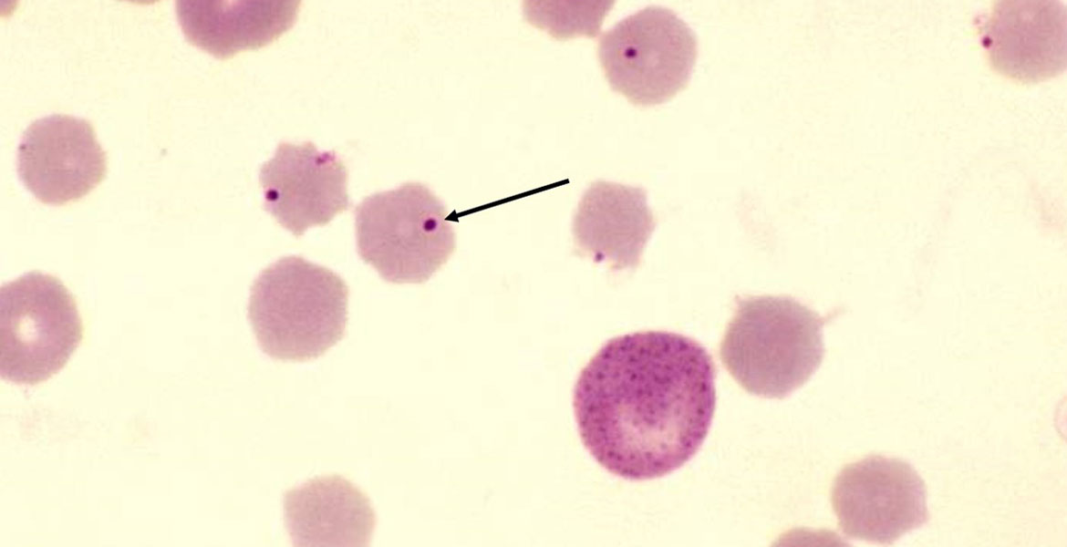
Diagnostic approaches for rapid detection of herd-level infections
Bovine anaplasmosis (BA) caused by the obligate intraerythrocytic, rickettsial organism Anaplasma marginale is endemic in tropical and sub-tropical regions globally
Estimated economic impact of $660 per clinically affected head in the United States
BA induces production losses through several means. Infections of adult naïve cattle result in anemia, abortion, and acute death
Infection of young calves establishes an inapparent carrier state where the animal may serve as a reservoir for infection
https://news.okstate.edu/
David R. Smith, DVM, PhD, Dipl. ACVPM, Dipl. Epidemiology
W. Isaac Jumper, DVM, PhD, Dipl. ACVPM
Kimberly A. Woodruff, DVM, MS, Dipl. ACVPM, Dipl. Epidemiology
Bindu Nanduri, PhD

Slide 2

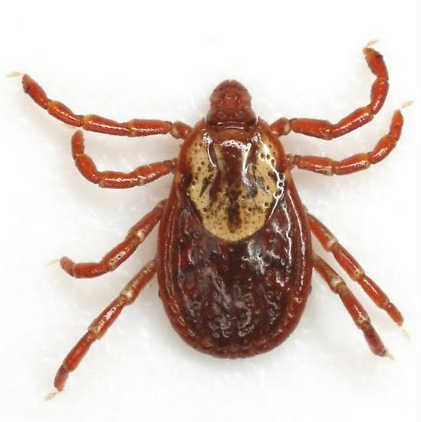
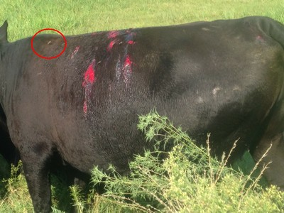
Use of arthropod vectors to classify cattle herds by anaplasmosis infection status
Anaplasma marginale is endemic to the southeastern and northwestern United States
Tabanid flies as mechanical vectors
Dermacenter ticks as biological vectors
Anaplasma marginale organisms
replicate in the tick.
Blood feeding transmits
Anaplasma marginale directly from host to host
https://bugguide.net/node/view/560099

Slide 3
Objectives
The goal is to determine whether a non-invasive method of sampling to detect A. marginale in free-living vector species, may be used to estimate the seroprevalence of anaplasmosis in cattle on the same pastures.
Determine the optimal sampling strategy for Dermacentor variabilis
Estimate the proportion of D. variabilis among ticks captured by dragging
Determine the optimal sampling strategy for female tabanids
Estimate the proportion of female tabanids among insects captured by H-trap
Relate to seroprevalence of anaplasmosis in adjacent cattle herds

Slide 4

Cross-sectional study: estimate prevalence and identify risk factors associated with diseases of beef cattle in Mississippi
W. Isaac Jumper, DVM, PhD, Dipl. ACVPM
Carla L. Huston, DVM, PhD, Dipl. ACVPM, Dipl. Epidemiology
Brandi B. Karisch, PhD, Animal and Dairy Sciences
David R. Smith, DVM, PhD, Dipl. ACVPM, Dipl. Epidemiology
In 2023, 860,000 beef cattle on 15,980 farms in Mississippi. 5th largest agriculture commodity in MS
Prevalence and risk factors for some production-limiting diseases are not well known
Bovine anaplasmosis
Bluetongue virus
Bovine leukemia virus
Neospora caninum
Leptospirosis
Bovine Viral Diarrhea Virus

Slide 5
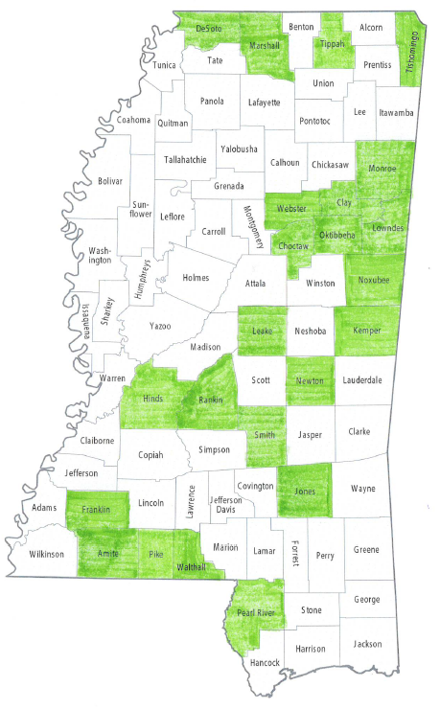
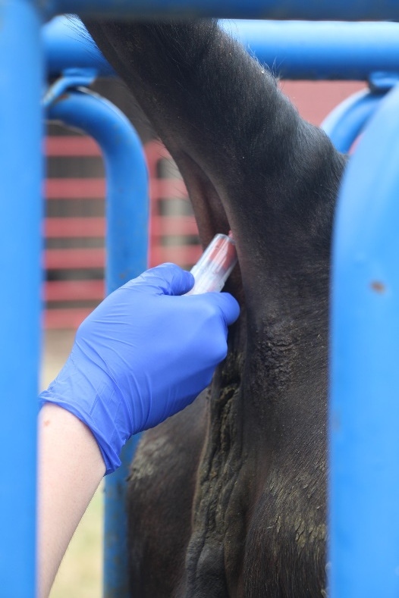
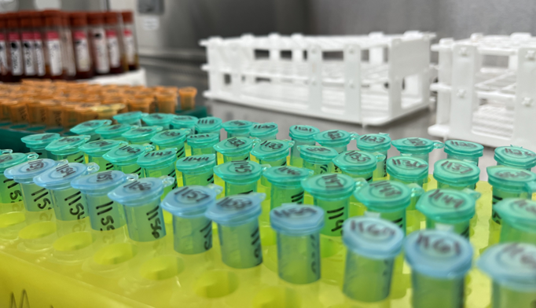
Status of sample collection
Objective
Describe within and between herd prevalence, geographical distribution, as well as management and biosecurity risk factors for various production-limiting diseases of beef cattle in Mississippi
Blood samples collected from cattle in 40 herds in 23 counties across the state
2,112 total serum samples collected
Initial sample size calculations have been met (n=40)
Sample collection will continue as herds are available
Serum testing currently underway

Slide 6
Preliminary results
17/20 herds had at least 1 animal test positive
3 herds had 0 animals test positive
Antimicrobials may be used to treat disease or mitigate risk
In-feed antimicrobial use raises stewardship concerns
Impact of feeding chlortetracycline (CTC) on BA seroprevalence

Slide 7
What is the effect of policies against the use of antimicrobials in beef production on profit and animal well-being?
System dynamics model of beef production antimicrobial stewardship
Some cattle feeders desire lightweight calves despite increased risk for pneumonia. The problem is currently mitigated with mass antimicrobial therapy
Notes:
Pre analytical phase – sample collection and handling
- inappropriate test request
- misidentification of sample
- collection
- storage and transportation
Analytical – performance of the diagnostic test
- equipment malfunction
-sample mix up
- quality control failure
Post analytical – test result reporting and interpretation
-excessive turnaround time
- improper data entry
- loss of followup

Slide 8
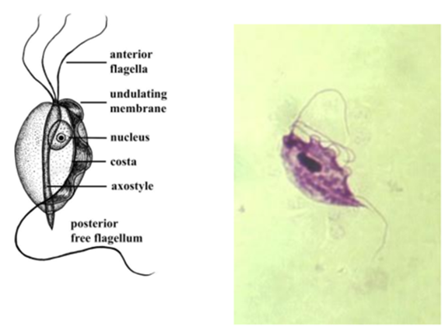
Test performance of normal saline as a transport medium for detection of Tritrichomonas foetus in cattle herds by qRT-PCR
David R. Smith, DVM, PhD, Dipl. ACVPM, Dipl. Epidemiology
Obligate extracellular protozoan
Venereal transmission
Clinical signs → reproductive losses
Bull = asymptomatic carrier
Economic impact
$650 million annually (Speer CA, 1991)
$44,000/ year for cow-calf producer (Anderson, 2014)
No FDA approved treatment
Image courtesy of Google Images
Notes:
Add all people to this slide!!!

Slide 9


Machine Learning/Deep Learning/Graph Neural Networks
Mahalingam Ramkumar, PhD
Zhiqian Chen, PhD
Nisha Pillai, PhD
Dept. Of Computer Science and Engineering
Bindu Nanduri, PhD
College of Veterinary Medicine
Moses B Ayoola PhD, Santhanakrishnan Boopalan PhD, Athish R Das MS, Ganga Gireesan MS

Slide 10
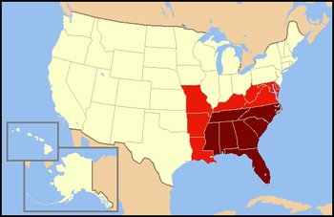
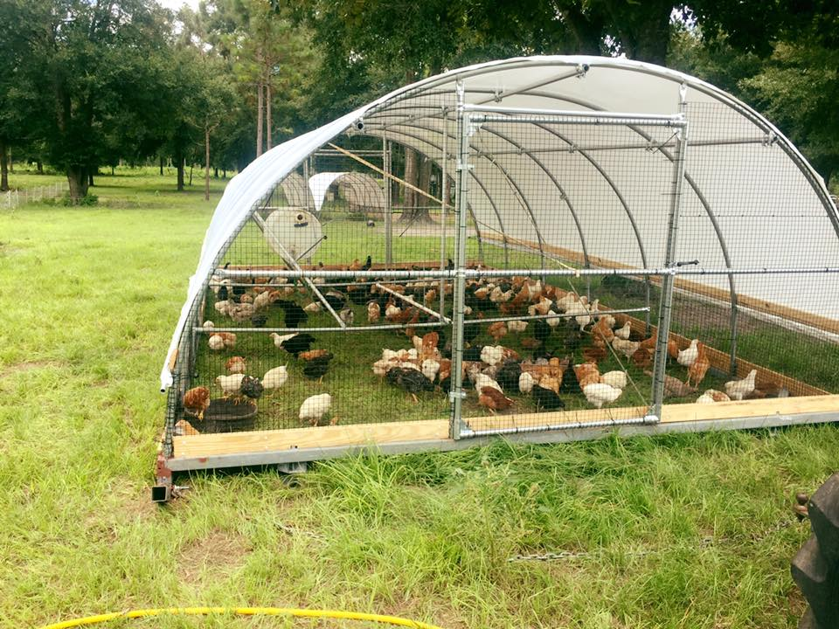
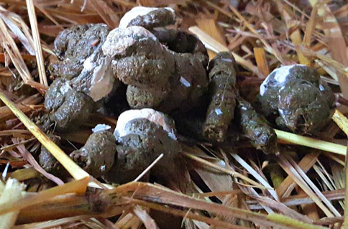
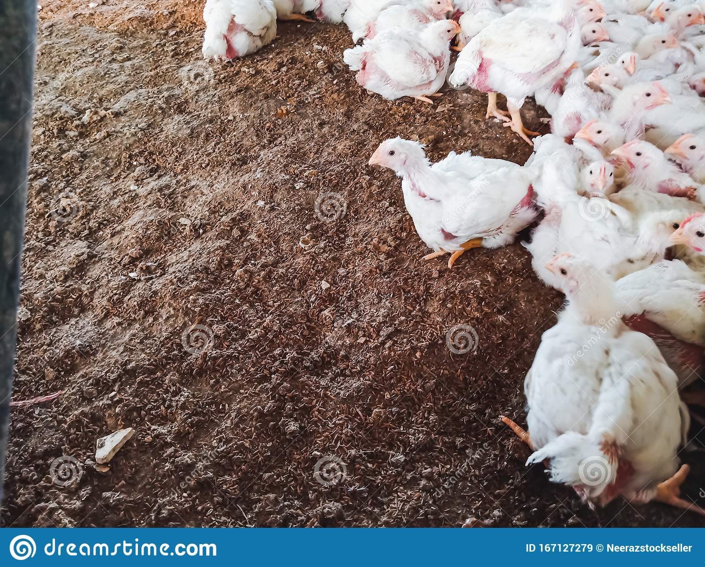

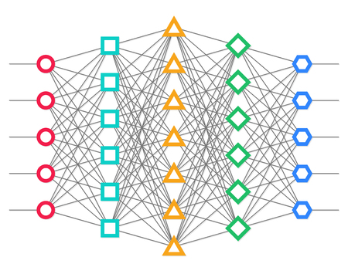
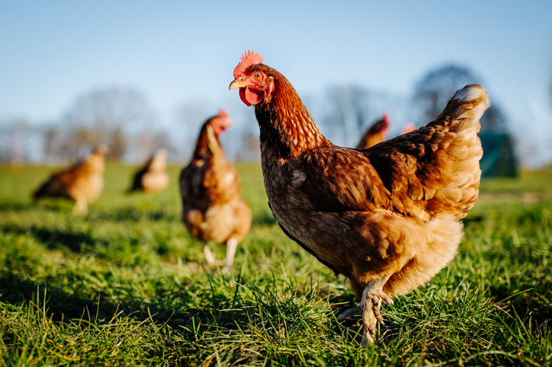
Preharvest Environmental and Management Drivers of Multi-Drug Resistance in Major Bacterial Zoonotic Pathogens in Pastured Poultry Flocks
Dataset
Approach
Influential Elements
SHAP
Predicts direction
Influential Variables
Salmonella
Listeria
Phosphorus
Low pH
Low EC
High Manganese
Low Sodium
Magnesium
Phosphorus
Flock Size
Potassium
Copper
YearsFarming
Bagging (≥3 Algorithms Agree)
11 Southeastern Poultry Farms
1. RandomForest
4. Autoencoder
2. XGBoost
5. GAN
3. MLP
Feces
Soil
31 Farm Practices + 24 Physiochemical Properties Collected for Each Sample
Machine/Deep Learning
Michael J. Rothrock, PhD
USDA-ARS
Athens, GA
Microorganisms 2022, 10(9), 1703

Slide 11
Dataset
Pastured Poultry
Management Practices, Soil physicochemical properties
Food safety: zoonotic bacterial pathogens
Antibiotic Resistance, MDR
Microbiome
Models
Models for pathogens (Campylobacter, Listeria, Salmonella), MDR
Ensemble approach
Pair-Difference model
(N x M to N² x 2M)
Explainable AI
Order of importance
Combinatorial optimization
Important feature pairs
Important triplets
…
Deep sensitivity analysis for objective-oriented combinatorial optimization. International Conference on Computational Science & Computational Intelligence (CSCI'23)
Towards Interpreting Multi-Objective Feature Associations, International Systems Conference (IEEE SysCon 2024)
Predicting foodborne pathogens and probiotics taxa within poultry-related microbiomes using a machine learning approach. Anim Microbiome. 2023
Towards optimal microbiome to inhibit multidrug resistance. IEEE Conference on Computational Intelligence in Bioinformatics and Computational Biology (CIBCB) 2023.
Bayesian-Guided Generation of Synthetic Microbiomes with Minimized Pathogenicity. International Conference of the IEEE Engineering in Medicine and Biology Society (IEEE EMBCm 2024)
EndToEndML: An Open-Source End-to-End Pipeline for Machine Learning Applications. International Conference on Information and Computer Technologies (ICICT 2024, March 15-17).

Slide 12



NARMS
Antibiotic Resistance (250000 samples)
4500 nontyphoidal Salmonella whole genome sequences
MIC for 15 antibiotics
Traditional machine learning (random forest) with deep learning models (multilayer perceptron and DeepLift) for WGS-based MIC prediction using K-mers.
Predicting Salmonella MIC and deciphering genomic determinants of antibiotic resistance and susceptibility. Microorganisms. 2024; Jan 10; 12(1): 134

Slide 13
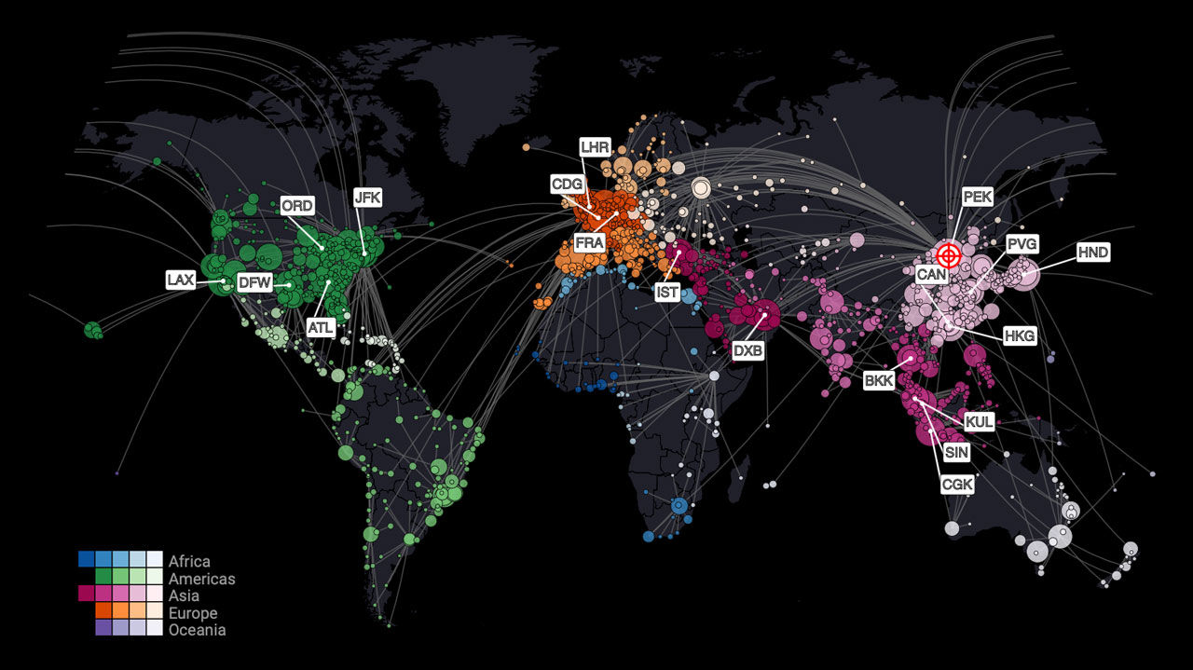

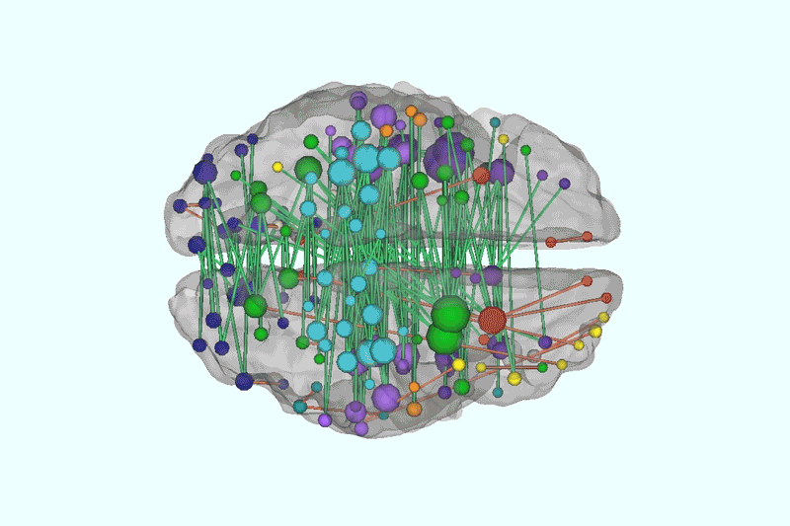

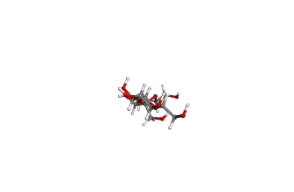
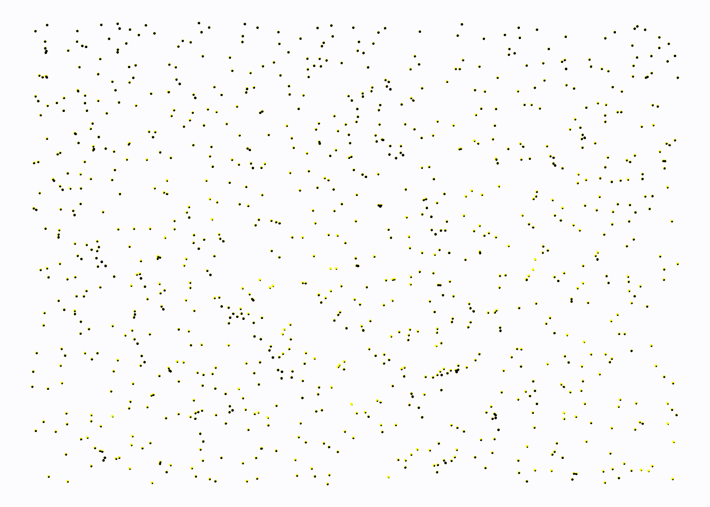
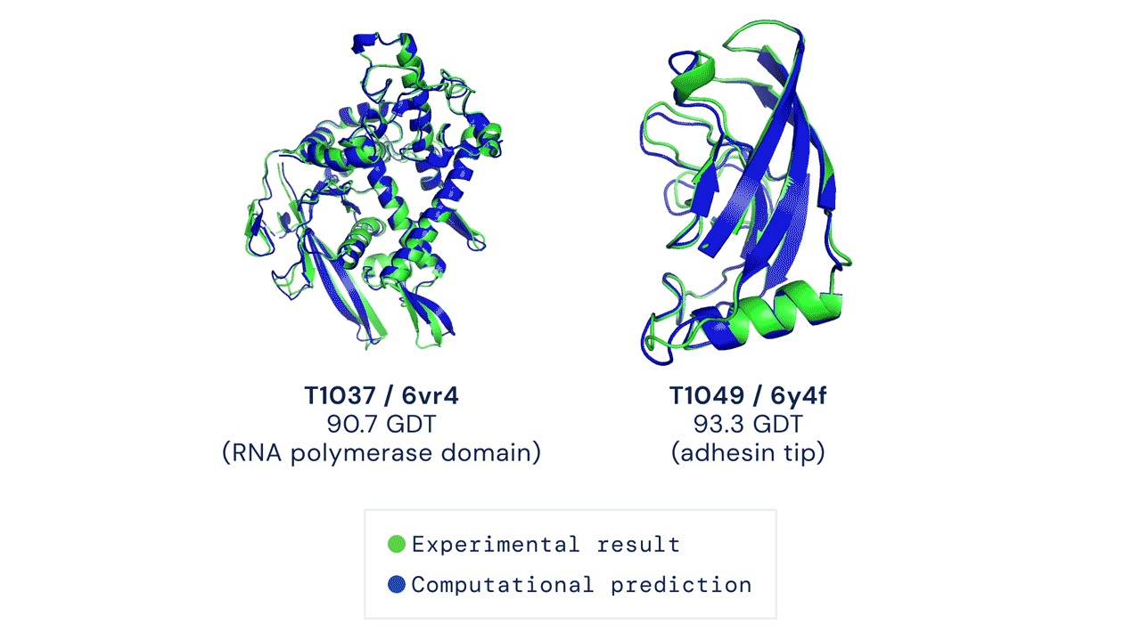

Graph is Everywhere
Graph dynamics
Disease spread
Social Networks
Epidemic
Internet
Brain
Chemical Structure
Particle System (Physics)
Internet of Things
Notes:
Graphs are powerful mathematical abstractions that can describe complex systems of relations and interactions in fields ranging from biology and high-energy physics to social science and economics.

Slide 14
Graph Neural Networks (GNN) for MIC Prediction
GNNs offer advantages over conventional ML methods by incorporating connectivity, topology, and non-Euclidean data into the learning process.
K-mer GNN model
Nodes are k-mers, edges show sequence similarity
Encodes k-mer presence/absence as features
Integrates graph structure and sequence data
Allows predicting MICs and understanding resistance
Evaluated Salmonella MIC prediction model by conducting comparative analyses with including Linear Regression, Random Forest Regressor (RF), Support Vector Regressor(SVR), and XGBoost (XGB).
Leveraging Graph Neural Networks for MIC Prediction in Antimicrobial Resistance Studies. International Conference of the IEEE Engineering in Medicine & Biology Society, 2024
Notes:
Graphs are powerful mathematical abstractions that can describe complex systems of relations and interactions in fields ranging from biology and high-energy physics to social science and economics.

Slide 15
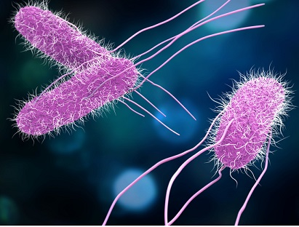
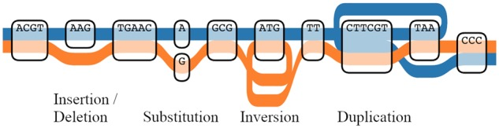
Ongoing / Planned Work
Salmonella genomes (over 550,000)
Pan Genome Graph
80,000 with labelled MIC
6000 in NARMS
Bioinformatics, 2019
Fda.gov/food/foodborne-pathogens/salmonella
Purpose: a core model to allow fine tuning of smaller models
Not trained to just predict next / missing token
Predict all available labels
API for going from genome subsequence (in a sample window) to trainable labels
Pros and Cons of generative (GPT like) or predictive (Bert-like)
GNN for serotype prediction
LLM for Salmonella
USDA-ARS : Adam Rivers, GBRU, GEERU, Gainesville, FL Jonathan Frye, Athens, GA.
Notes:
Graphs are powerful mathematical abstractions that can describe complex systems of relations and interactions in fields ranging from biology and high-energy physics to social science and economics.

Slide 16

LLM for Microbiomes
USDA Science Blueprint 2020-2025
Variety of small microbiome abundance data available
From a wide range of unrelated experiments
Different types of samples
Different species, soil, feces
USDA-ARS: Michael J. Rothrock & Adelumola Oladeinde , Athens, GA, Laxmi Yeruva, Little Rock, AR
Notes:
Graphs are powerful mathematical abstractions that can describe complex systems of relations and interactions in fields ranging from biology and high-energy physics to social science and economics.

Slide 17
Transformers for Tabular Data
ML models ignore the deeper meaning of “features”
Input variables like temperature, salinity, E. coli CFUs, etc., are just x₁, x₂,.. x_{n} for the model
Are reasonably good embeddings possible for various features?
Using data created for possibly unrelated and even unknown purposes…
Better explainability
Attention matrix can be interpreted as an edge graph showing transition probabilities
A model for feature importance (calculable for every sample) using PageRank
Exploring Pathogen Presence Prediction in Pastured Poultry Farms through Transformer-Based Models and Attention Mechanism Explainability. (Ready for submission)
Michael J. Rothrock, USDA-ARS, Athens, GA.
Notes:
Graphs are powerful mathematical abstractions that can describe complex systems of relations and interactions in fields ranging from biology and high-energy physics to social science and economics.

Slide 18

Realtime Animal Health Monitoring
Current Research: Real-time pasture surveillance tool using drones and remotely sensed data
Animal counts, weight, and body temperature
Mass and nutritional value
Thermal, hyper, 3-D, and multispectral data
Convolutional Neural Networks, Vision Transformers
Objective: Develop Artificial Intelligence based Smart Tools for Farmers for detecting animal disease and responding to animal welfare challenges
Amanda Ashworth, USDA-ARS, Fayetteville, AR.
Notes:
Graphs are powerful mathematical abstractions that can describe complex systems of relations and interactions in fields ranging from biology and high-energy physics to social science and economics.

Slide 19
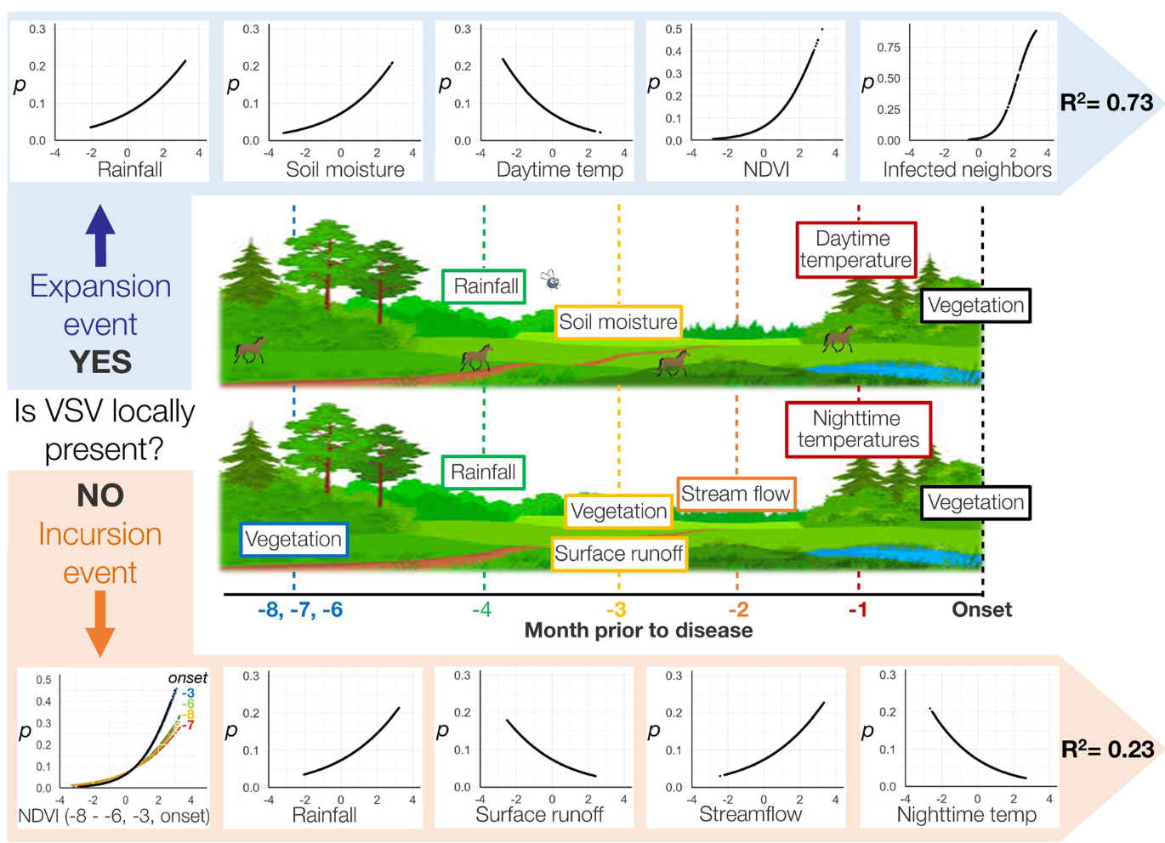
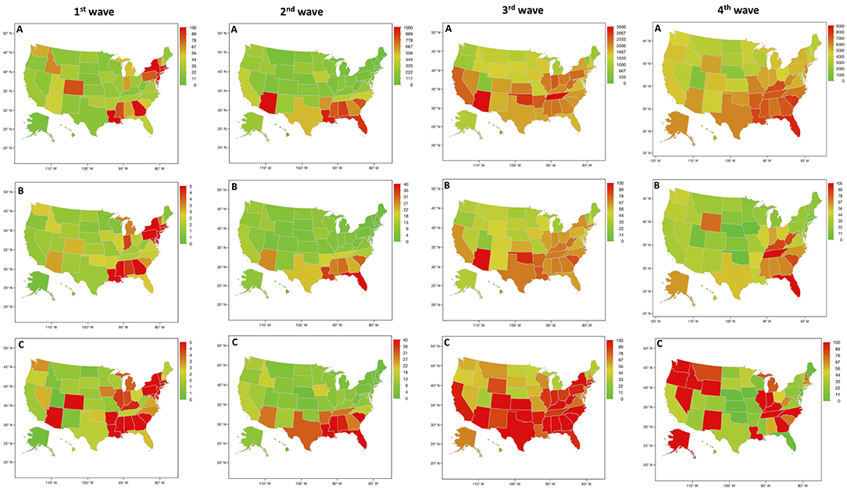
Spatial Modeling the Spread of Vesicular Stomatitis (VS)
Research: When will VS enter the US? Once VS does spread into the US, where will it go next?
Microcosmic: temperature, soil moisture, vegetation, etc
Macroscopic: geospatial propagation patterns
Peters et al. 2020 Ecosphere
Alexandre 2022 Frontiers in public health
Microcosmic: ecological factor
+
Macroscopic: Geospatial patterns
Amy R Hudson, USDA-ARS, Manhattan, KS.
Notes:
Graphs are powerful mathematical abstractions that can describe complex systems of relations and interactions in fields ranging from biology and high-energy physics to social science and economics.

Slide 20
Research Plan
To integrate Macroscopic and Microcosmic factors
Epidemic Modeling with Spatial Constraints: Integrate traditional epidemiological models, such as the SIR with spatial graph structures.
To reduce the data demand
Bayesian Inference for spatial graph: Employ Bayesian inference techniques to quantify the uncertainty in disease spreading predictions and model parameters. This could involve developing hierarchical Bayesian models or using Markov Chain Monte Carlo (MCMC) methods to estimate posterior distributions over the model parameters, accounting for spatial and temporal uncertainties.
To unify and utilize different data granularities
Multi-Scale Modeling: Develop multi-scale models that capture disease spreading at different spatial resolutions, from individual-level interactions to regional or global-scale dynamics. This could maximize the utilization of data collected from every level.
To provide scientific conclusion
Causal Inference and Intervention Modeling: Explore causal inference techniques to identify the causal factors and interventions that can effectively mitigate disease spreading in spatial networks. This could involve methods like causal graphical models, counterfactual reasoning, or structural equation modeling, enabling the development of targeted interventions and policy recommendations.
Notes:
Graphs are powerful mathematical abstractions that can describe complex systems of relations and interactions in fields ranging from biology and high-energy physics to social science and economics.

